Slide 1
CONUS to F-OCONUS
Civilian PCS
Briefing
AFPC PCS Unit
March 2025

Slide 2
Agenda
Purpose
Definitions
PCS Process Steps
Selectee Responsibilities
Entrance on Duty
Travel Time
Mandatory Allowances
Discretionary Allowances
PCS Restriction(s)
PCS Tax Notification
PCS Order Status Check
Acronym Listing
Information / Resources

Slide 3

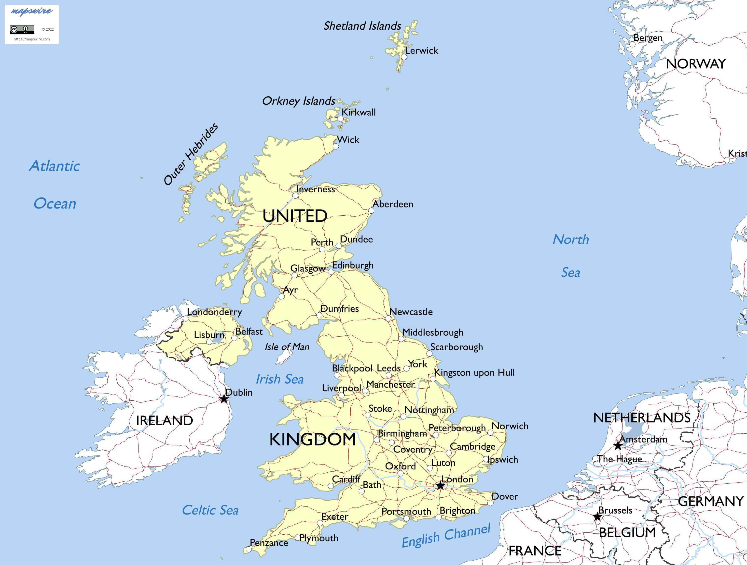
Purpose
Provide Civilian Permanent Change of Station (PCS) allowances for a career move from one Continental United States (CONUS) location (48 contiguous states) to a location Outside the Continental United States (F-OCONUS) location
  Example
    Hanscom Air Force Base, MA to Lakenheath AFB,UK
  Important! DO NOT make irreversible life changes, such as selling property, resigning from your current position, etc., prior to receipt of a Firm Job Offer and PCS orders

Slide 4
Definitions
Current Federal Civilian Employee: Refers to civilian employees already holding a position within the federal government, to exclude military. This could include other DoD agencies and/or other Federal agencies (including NAF)
Career Program Move: An Air Force centrally paid move to a Centrally Managed (CM) position
Centrally Managed Position: When properly identified on the position description and managed by the Career Field Teams (CFT); PCS is funded by the Central Salary Account (CSA) PCS account
Full Government Move: Government arranges HHG transportation.
Split Shipment Move: Employee may ship HHG by Government procured and personally procured transportation.
Self-Move: Employee arranges their own HHG transportation.

Slide 5
Definitions (cont'd)
Dual Federal Employees: When members of the same immediate household, are both transferred in the government’s interest, both members must sign in writing to elect to receive the travel and transportation allowances authorized as one of the following:
  Each employee separately – each employee is eligible for travel and transportation allowances as an employee, but is not treated as the other employee’s dependent
  Only one as an employee – the other employee is eligible for travel and transportation allowances as a dependent
  Duplication of Benefits not Authorized - employee and/or dependents cannot accept or receive duplicate or third-party reimbursement for the employee's covered relocation expenses.
Military Transitioning to Civilian Service: Separating or retiring military members are not considered current federal employees for purposes of their first civilian PCS - they are considered First Duty moves

Slide 6
PCS Process Steps
Step 1 – Human Resources (HR) Staffer initiates PCS process in USA Staffing (USAS)
  (This is the individual that extends the tentative job offer (TJO) to the selectee)
  Assigns PCS-1 and Transportation Agreement (DD Form 1617 or DD Form 1618)
  Completes all required questionnaire fields (Position, Employment, & Change of Station)
  Without all information filled in, selectee will be unable to sign
Step 2 – Selectee completes assigned tasks & signs PCS-1 & Transportation agreement
  If all areas are not filled in & signed, the staffer WILL NOT be able to initiate the request for PCS Orders
Step 3 – Gaining HRO must complete the Gaining Station Tab in its entirety
Step 4 – HR Staffer confirms tabs are completed and sends request for orders processing template email to PCS Team

Slide 7
PCS Process Steps (cont'd)
Step 5 – PCS Section (Gate Keeper) receives PCS Request
  Reviews documents / PCS forms in USAS
  Builds myFSS case and assigns to PCS Chief when documents are verified complete
  Step 6 – PCS Section Chief assigns PCS case to Technician
Step 7 – PCS Technician processes PCS orders (DD Form 1614)
  Reviews PCS documents in USAS for accuracy
Sends PCS Briefing, technician contact information, and request for any other documents required to selectee and courtesy copies all involved parties
Establishes Entrance on Duty (EOD) date upon receipt of information / documents
Builds order and cost sheet then forwards for quality control (QC) review
Step 8 – PCS Quality Check
  Reviews PCS orders and cost sheet for accuracy and forwards for funding allocation
Step 9 – PCS Technician forwards order for authentication based on position type

Slide 8
PCS Process Steps (cont'd)
Step 10 – Funding Authentication (Based on Position Type)
  Centrally Managed (CP):
  AFPC/FMY reviews documents, inputs funding citations, and authenticates orders
  Non-Centrally Managed (NCP):
  FM Certifying Official (gaining or losing CPS) authenticates and certifies orders
Step 11 – PCS Approver
  Centrally managed orders, Civ PCS section will approve and notify the HR staffer that the order is ready for release
  Non-centrally managed positions – CPS notifies HR Staffer orders are approved and ready for release
Step 12 – HR Staffer
  Verifies all position pre-employment requirements are completed; extends Firm Job Offer (FJO) and releases orders to selectee **REMINDER: Only AFPC and AFMC staffers can release PCS orders

Slide 9
Selectee Responsibilities
Ensure all information and documents are accurate and complete in USAS
See the PCS Required Documents List at the link below to help determine what additional documents and / or forms may be required prior to completing your PCS orders
https://www.afpc.af.mil/Civilian-Career-Management/Civilian-PCS/
  Examples include:
    Birth certificates and / or custody documents for children under 21 who do not share same last name of the selectee
    Marriage certificate for spouse that does not share same last name of the selectee
    Physician affidavit for children ages 21 and over incapable of self-support

Slide 10
Selectee Responsibilities (cont'd)
Contact designated PCS Technician if assistance is needed with understanding authorized entitlements and allowances
Once orders are received, contact nearest base transportation management office (TMO) to coordinate movement of household goods (HHG)
Submit final travel voucher to base finance office upon completion of PCS
Contact the Gaining CPS / unit to find out if there are any restrictions on shipment of goods or POV

Slide 11
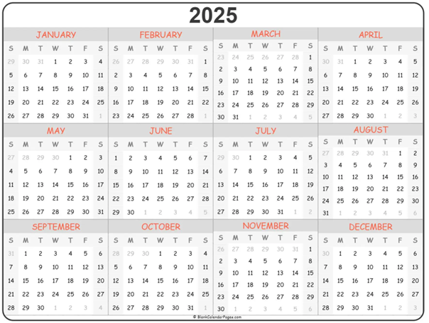
Entrance on Duty (EOD)
TIMELINES FOR ESTABLISHING EOD
  Once PCS Technician receives all completed forms and supporting documents, the EOD will be established
  EODs are set at 65 days out for Foreign OCONUS moves
  EODs must be set at the beginning of a new pay period (Sunday)
Example:
Completed PCS-1 and supporting documents were received by the PCS technician on 15 Jan 2025. 65 days from that date is 21 Mar 2025. The next closest pay period begins on 23 Mar 2025; therefore, the EOD will be 23 Mar 2025.

Slide 12
Entrance on Duty (EOD) (cont'd)
Exceptions: Senior Executive Service (SES), Civilian Strategic Leader Program (CSLP) Base Realignment & Closure (BRAC) & Priority Placement Program (PPP)
  SES / CSLP EODs are set by the organization and orders processed within 72 hours
  PPP EODs are normally set by the organization - must be within 30 days of a valid match for CONUS moves (45 days OCONUS) and orders processed within 72 hours
  BRAC EODs are set and maintained in accordance with base closure timelines

Slide 13
Travel Time
Employee should begin official travel on the first duty day following the EOD
  It is not required to perform PCS travel on a holiday or weekend, however if travel is performed, those days will be counted as travel days
    Exceptions: RIF, PPP, BRAC, and First Duty Hires
      RIF, PPP and BRAC Employees must travel on losing activity’s time
      First Duty hires will begin travel on their EOD date and will report for their first duty day on their On or About (O/A) date (as of 16 Dec 2024)
Actual Reporting date is determined by the number of travel days authorized
  Leave En-Route: Leave taken after departure from the old duty station but prior to arrival at the new duty station must be approved in advance of travel by the gaining supervisor
    If approved, the reporting date will be adjusted

Slide 14
Travel Time
(cont'd)
Dependent Travel: If dependent does not travel concurrently with employee, it is considered delayed and must be noted on PCS order
  All travel and transportation must be completed within 1 year from the employee’s date of physically reporting for duty.
  Employee will be responsible for authorized travel and transportation costs incurred after the 1 year, anniversary date of the transfer or appointment effective date (Ref: JTR, Para, 053712)

Slide 15
Mandatory Allowances
(1 of 5)
Once an agency decision is made to pay or reimburse relocation expenses all the mandatory allowances must be paid or reimbursed. Ref: JTR Ch. 5 Part F 0536, and FTR §302-3
  The Agency may not negotiate, deny, or reduce these allowances when the civilian employee meets the eligibility requirements.
  Case-by-case factors, such as cost-effectiveness, labor market conditions, and difficulty in filling the vacancy, form the basis for determining whether to offer PCS allowances.
  Budget constraints do not justify denying PCS allowances. Ref: JTR Ch. 5 Part F 053705
  These mandatory allowances include:
    Transportation & Per Diem – Employee & Authorized Dependent(s)
    Miscellaneous Expense Allowance (MEA) when moving a household
    Transportation of Household Goods (HHG), including Storage in Transit (SIT)
    Relocation Income Tax Allowance (RITA)

Slide 16
Mandatory Allowances
(2 of 5)
TRANSPORTATION & PER DIEM - Employee & authorized dependent(s)
Includes travel between old and new Permanent Duty Station (PDS) – Airfare, lodging, meals & incidentals while in a travel status
It is mandatory policy for all travelers to use an available Travel Management Company (TMC) for all official transportation requirements
Employee must book travel with a contracted carrier
It is the general policy of the DoD that the Gov’t Travel Charge Card (GTCC) be used to pay for official travel and transportation related expenses
  If individual is not a GTCC holder, tickets should be purchased using a GTCC centrally billed account (CBA). If assistance is needed, please contact your gaining CPS
  Rental Car reimbursement at Gov’t expense for PCS travel is NOT authorized
Employee and Dependent travel must be completed within 1 year from the employee’s transfer or appointment effective date

Slide 17
Mandatory Allowances
(3 of 5)
MISCELLANEOUS EXPENSE ALLOWANCE (MEA) when moving a household
  Fixed rate paid at $905 w/out dependents & $1,810 w/ dependents
  Actual reimbursement may be authorized
    Employees with Dependents - reimbursement cannot exceed two weeks of employee’s basic salary rate
    Employees without Dependents – reimbursement cannot exceed one week of employee’s basic salary rate
    Information on MEA, and types of expenses covered, can be accessed on the myFSS website at: https://myfss.us.af.mil/USAFCommunity/s/knowledge-detail?pid=kA0t0000000LHJsCAO
    First duty station moves, SES last moves, separation and retirement moves not eligible

Slide 18
Mandatory Allowances
(4 of 5)
Transportation of Household Goods (HHG), Including Storage in Transit (SIT)
HHG authorized up to 18,000 lbs plus 2,000 (or 10 percent) of packing material allowance
Must be shipped within 12 months of date employee reported to new duty location
Government Bill of Lading (GBL) - Govt arranges w/carrier & responsible for payment
Self-Move - Employee arranges their own HHG transportation and pays for the move
    Reimbursement is limited to the actual expenses incurred by the employee, NOT TO EXCEED the cost of a government arranged move
Information on HHG can be accessed on the myFSS website at: https://myfss.us.af.mil/USAFCommunity/s/knowledge-detail?pid=kA0t0000000LHJsCAO
Information on SIT can be accessed on the myFSS website at: https://myfss.us.af.mil/USAFCommunity/s/knowledge-detail?pid=kA0t0000000LHJiCAO

Slide 19
Mandatory Allowances
(5 of 5)
Relocation Income Tax Allowance (RITA)
  Certain PCS entitlements & allowances are taxable to Federal & State
  RITA is designed to compensate relocating employees for additional tax liability they incur as a result of a Gov’t paid PCS move
  Information on RITA can be accessed on the myFSS website at: https://myfss.us.af.mil/USAFCommunity/s/knowledge-detail?pid=kA0t0000000LHJsCAO

Slide 20
Discretionary Allowances
(1 of 6)
Unlike Mandatory Allowances that must be paid if an employee meets the eligibility requirements, Discretionary Allowances are authorized at the discretion of the employing activity / DoD Component
These discretionary allowances may or may not include:
  Privately Owned Vehicle (POV) Shipment
  Property Management Service (PMS)
  Non-Temporary Storage (NTS) (Extended Storage) of HHG
  Temporary Quarters Subsistence Allowance (TQSA)
  Foreign Transfer Allowance (FTA)
If PCS is locally funded (non-centrally managed move), check with the gaining organization for authorized allowances

Slide 21
Discretionary Allowances
(2 of 6)
Privately Owned Vehicle (POV) SHIPMENT
May be authorized if it is in the Gov’t’s interest for the employee to have a POV at the OCONUS PDS
If authorized, only one POV may be shipped at government expense.
If authorized, POV must be in operating order and legally titled and tagged for driving
Contact the nearest TMO for shipment arrangements
Certain F-OCONUS locations do not authorize POV shipment
  Please contact your local TMO to determine if any restrictions exist for shipping a POV to your gaining location.
Information on POV Shipment can be accessed on the myFSS website at:
  https://myfss.us.af.mil/USAFCommunity/s/knowledge-detail?pid=kA0t0000000LHJaCAO

Slide 22
Discretionary Allowances
(3 of 6)
PROPERTY MANAGEMENT SERVICES (PMS)
  Applies only to those who would be eligible to sell a residence at Government expense. (Centrally Managed position at GS-12 or higher)
  When authorized, employee bears costs up front and may request reimbursement at a minimum of every 6 months, but not to exceed 12 months
  If eligible, employee must submit a request for authorization of PM Services to: afpcresourcesoffice@us.af.mil
  Additional information on PMS can be accessed on the myFSS website at: https://myfss.us.af.mil/USAFCommunity/s/knowledge-detail?pid=kA0t0000000LHJyCAO

Slide 23
Discretionary Allowances
(4 of 6)
NON-TEMPORARY STORAGE (NTS) (extended storage) of HHG
Combined weight stored and transported must not exceed the authorized maximum 18,000 lbs. net weight
NTS is funded by your overseas command. Your eligibility to retain your HHGs in NTS, at Government expense, depends upon your gaining funding authority submitting a new fund cite at the beginning of each fiscal year to the TMO servicing your NTS
It is your responsibility to ensure this fund cite is received by your servicing TMO. Failure to update funding will result in your NTS converting to your expense.
NOTE: The gaining funding authority is responsible for providing the NTS fund cite even if the PCS move is funded by the Central Salary Account (CSA)
Information on NTS can be accessed on the myFSS website at: https://myfss.us.af.mil/USAFCommunity/s/knowledge-detail?pid=kA0t0000000LHJsCAO

Slide 24
Discretionary Allowances
(5 of 6)
TEMPORARY QUARTERS SUBSISTENCE ALLOWANCE (TQSA)
  Covers lodging, meals & laundry at new PDS while searching for housing
  Reimbursed to employee at the gaining organization under DSSR entitlements
  Must keep receipts & itemize expenses
  May be reimbursed up to a maximum of 90 days
  Employee should contact the OCONUS CPS to verify TQSA eligibility and process
  Employee should contact the foreign duty station CPS to verify TQSA eligibility and process
  Information on TQSA can be accessed in the Department of State Standardized Regulations at: https://aoprals.state.gov/

Slide 25
Discretionary Allowances
(6 of 6)
FOREIGN TRANSFER ALLOWANCE (FTA)
  Note: This is discretionary and may/may not be paid
  If authorized:
Typically includes 10 days of pre-departure subsistence expense allowance (lodging & meals at losing PDS)
    Must depart from old PDS
    Employee should contact the OCONUS CPS to verify FTA eligibility and process
  Information on FTA can be accessed on the myFSS website at: https://myfss.us.af.mil/USAFCommunity/s/knowledge-detail?pid=kA0t0000000LHJcCAO

Slide 26
PCS Restrictions
The JTR restricts any employee who is serving under a services agreement (formerly transportation agreement) as a result of a Gov’t sponsored PCS move from a second PCS move within a 12-month period (Ref: JTR, Para 053706)

Slide 27
PCS Tax Notification
In accordance with the Tax Cuts and Jobs Act (TCJA) 22 Dec 2017, moving expenses and relocation payments paid by an employer on and after January 1, 2018, are taxable.
  Air Force reports transportation cost associated with a move to the IRS and pay the taxes on behalf of the employee
    This creates a debt to the Air Force and a tax liability to the employee
    Employee will be notified of the debt via mail
    Air Force offers several repayment plan options
      There is NOT a waiver option for tax indebtedness
  ***A Travel W-2 will be processed at the end of the year and will include the increase in gross income, taxes for all PCS-related vouchers filed, and HHGs. W-2s will be mailed to employees and are also available through myPay. Employees will file their tax return for the calendar year and subsequently file a Relocation Income Tax Allowance (RITA) voucher to help offset the additional tax burden imposed by the PCS move. This is not a 100-percent dollar for dollar offset as each individual’s tax situation is unique.***

Slide 28
PCS Order Status Check
Selectee can check the status of their PCS order 24 hours a day by accessing the myFSS website at: https://myfss.us.af.mil/USAFCommunity/s/
Status | Description
RECEIVED – PENDING ASNG TO TECH | Chief of the PCS Unit has received request for PCS orders, and is determining which PCS Tech to assign
CLERK PREPARING | PCS Tech has received request and is building PCS orders
AWAITING OTHER DOCS | PCS Tech is unable to complete processing of PCS orders and has contacted employee for further documents / information
QC COMPLETE | PCS orders have been completed, an additional quality check review has been completed
RETURNED/CORRECTIONS | PCS orders have been returned to PCS Tech for corrections
CM/LOCAL AUTHENTICATION | AFPC or Local Finance are authenticating the orders
PENDING APPROVAL | PCS order has been certified and is now pending final approval
CLOSED | PCS order request is complete and closed
CWOA SOLVED (CLOSED WITHOUT ACTION SOLVED) | PCS order request has been closed without action. For example: employee declines the job offer after initially accepting and starting the PCS process

Slide 29
Acronym Listing
(1 of 4)
AFMAN – Air Force Manual
AFPC – Air Force Personnel Center
BRAC – Base Re-Alignment and Closure
CFT – Career Field Team
CSA – Central Salaried Account
CPS – Civilian Personnel Section
CONUS – Continental United States (48 contiguous states)
CTO – (Contracted) Commercial Travel Office
DoD – Department of Defense
DTMO – Defense Travel Management Office
DNRP – Defense National Relocation Program

Slide 30
Acronym Listing
(2 of 4)
DSSR – Department of State Standardized Regulations
EOD – Entrance on Duty
FTA – Foreign Transfer Allowance
GHS – Guaranteed Home Sale
GTCC – Government Travel Charge Card
HHG - Household Goods
HHT – House Hunting Trip
HR – Human Resources
JTR – Joint Travel Regulations
KCP – Key Career Position
MEA – Miscellaneous Expense Allowance

Slide 31
Acronym Listing
(3 of 4)
MYFSS – My Force Support Squadron
NF OCONUS– Non-Foreign OCONUS (Alaska, Guam, Hawaii, and other U.S. territories)
NTS – Non-Temporary Storage
OCONUS – Outside the Continental United States (Europe, Asia etc.)
OPM – Office of Personnel Management
PCS – Permanent Change of Station
PDS – Permanent Duty Station
PMS – Property Management Services
POV – Privately Owned Vehicle
PPP – Priority Placement Program
RIF – Reduction in Force

Slide 32
Acronym Listing
(4 of 4)
RITA – Relocation Income Tax Allowance
SIT – Storage in Transit
TJO – Tentative Job Offer
TMO – Transportation Management Office
TQSA – Temporary Quarters Subsistence Allowance (OCONUS ONLY)
TQSE – Temporary Quarters Subsistence Expense (CONUS & NON FOREIGN OCONUS ONLY)
USAS – USA Staffing

Slide 33
Information / Resources
PCS Videos are available at: https://www.afpc.af.mil/Civilian-Career-Management/Civilian-PCS/
For Entitlements and Allowances / Joint Travel Regulation
  https://www.defensetravel.dod.mil/Docs/perdiem/JTR.pdf
For all Household goods, POV shipment and GBL cost comparison related questions contact your nearest TMO
  https://www.militaryonesource.mil/moving-pcs/
For reimbursement, travel rates and other finance related questions contact your gaining Comptroller Squadron civilian pay office
  https://www.dfas.mil/CivilianEmployees/Civilian-Permanent-Change-of-Station-PCS/
Department of State Standardized Regulations (DSSR)
  https://aoprals.state.gov/
DAFMAN 36-142, Civilian Career Field Management and Centrally Managed Programs
  https://static.e-publishing.af.mil/production/1/af_a1/publication/dafman36-142/dafman36-142.pdf

Slide 34

The Air Force’s Personnel Center

